Slide 1
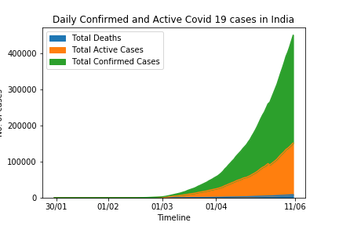
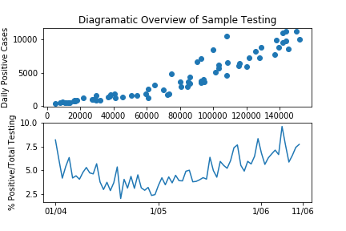
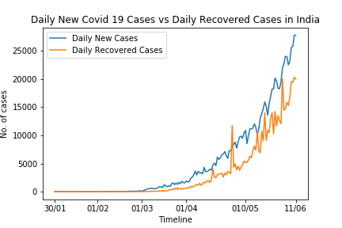
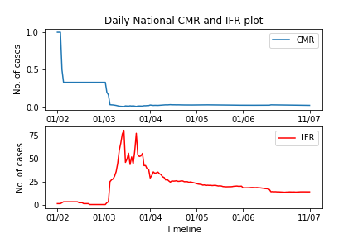
PRESENT ANALYTICS - INDIA

Slide 2
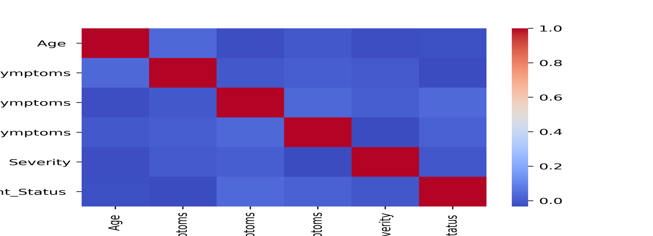
Correlation Study Through Heatmap
Study on a dataset consisting 3135 individual from different age brackets diagonzed with either FLU or COVID 19, with various types of symptoms of multiple degrees of extent.
Conclusion: The association between COVID 19 positive with symptoms, degree of health issues or age, is very low. ➔ individual with severe symptoms can be diagonosed with flu, not covid 19.
What causes or influence COVID 19 is inconclusive: Need for thinking OUT OF THE BOX

Slide 3
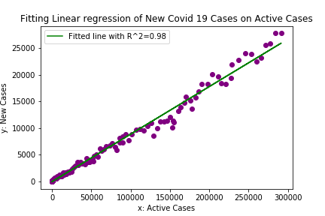
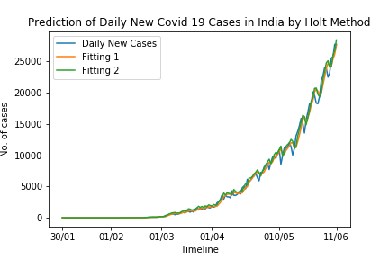
Models For Prediction
Fitting of Daily New Cases through Linear regression on Active Cases of the previous day
Time Series modeling of Daily New Cases using Holt’s method

Slide 4
Classifiers for gauging severity
Dataset
Target: Covid 19 OR Flu ??
Set of Classifiers:
Age
Serious symptoms
Most important Symptoms
Less imoportant symptoms,
Severity
#individuals: 3135
Method Used:
SVM
(Accuracy = 0.46)
Decission Tree (Accuracy = 0.7)
[ 75% used as trainee set, 25% used as test set]

